Slide 1
Chapter 2: Voyage Charter
Section 1: Introductory Clauses
Section 2: Cargo & Freight Clauses
Section 3: Loading and Discharging
Clauses
Section 4: Other clauses

Slide 2
Standard Voyage Charter Forms www.bimco.org
AMWELSH 93
AUSTWHEAT 1990
BIMCHEMVOY 2008
BISCOILVOY1986
BLACKSEAWOOD
CEMENTVOY 2006
COAL-OREVOY
CRUISEVOY
GASVOY 2005
GRAINCON
HEAVYCON 2007
HEAVYLIFTVOY
INTERCONSEC 76
NIPPONCOAL
NIPPONORE
NORGRAIN 89
NUBALTWOOD
PANSTONE
POLCOALVOY
TANKERVOY 87
Gencon 94

Slide 3
Section 1 Introductory clauses
1. Description of the vessel
2. The agreed voyage

Slide 4
1. Description of the vessel
Condition, warranty or intermediate term?
---many items of description are likely to be regarded as intermediate terms
When the ship must comply?
the date of charter? throughout the voyage? Decisions vary.

Slide 5
Named vessel / to be nominated / substitution:
--- Is shipowners entitled to change the name ? (not if it is of value to charterers)
--- Where the charter provides that the nomination shall be made within a specified time, a failure to nominate punctually is a breach of condition.
--- no implied liberty to substitute

Slide 6

Liberty to substitute:
“substituting a vessel of similar size and position at any time before or during this charterparty…”
Does it allow only one
substitution or more?

Slide 7
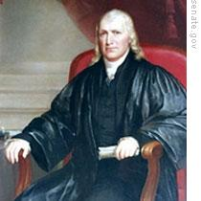
“…having regard to the length of the charter and the commercial purpose of the clause, the intention was clear that the owners should be entitled to substitute whenever it might become convenient to do so.”

Slide 8
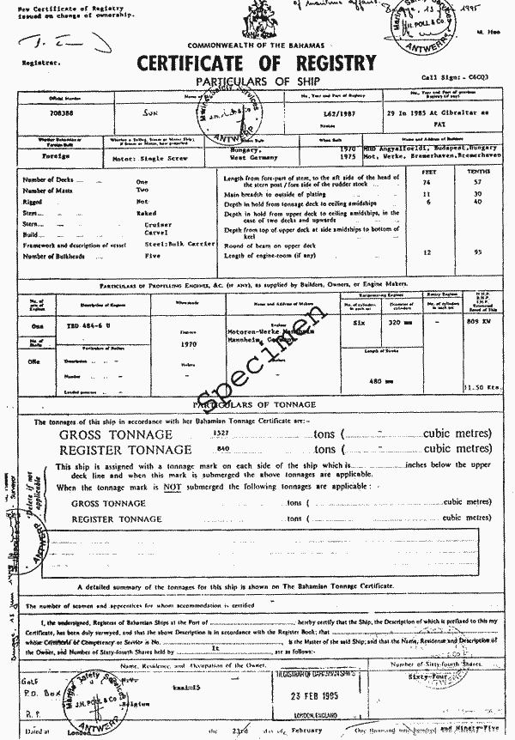
Vessel’s tonnage
GRT/NRT
Deadweight tonnage/ capacity
Cubic capacity (bale/grain)

Slide 9
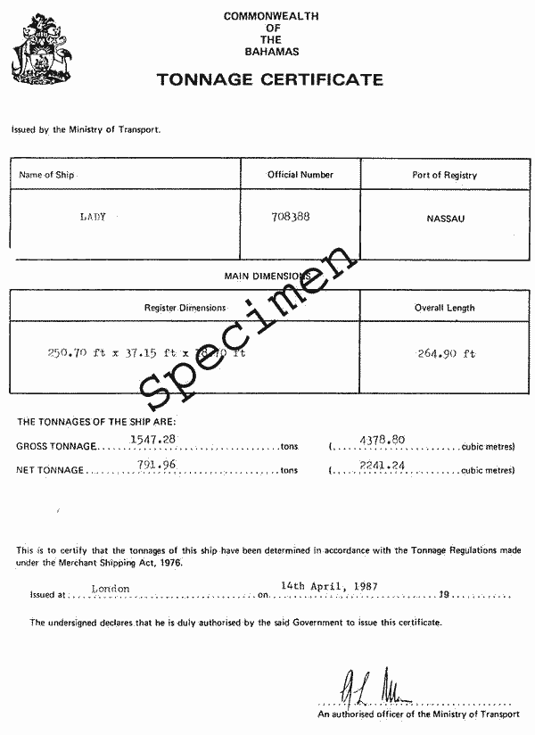

Slide 10
DWT---means the weight of cargo the vessel is capable of carrying when loaded down at its maximum permitted draught. (“DWCT”)
The statement do not amount to guarantee---much depend on stowage factor of the cargo;

Slide 11
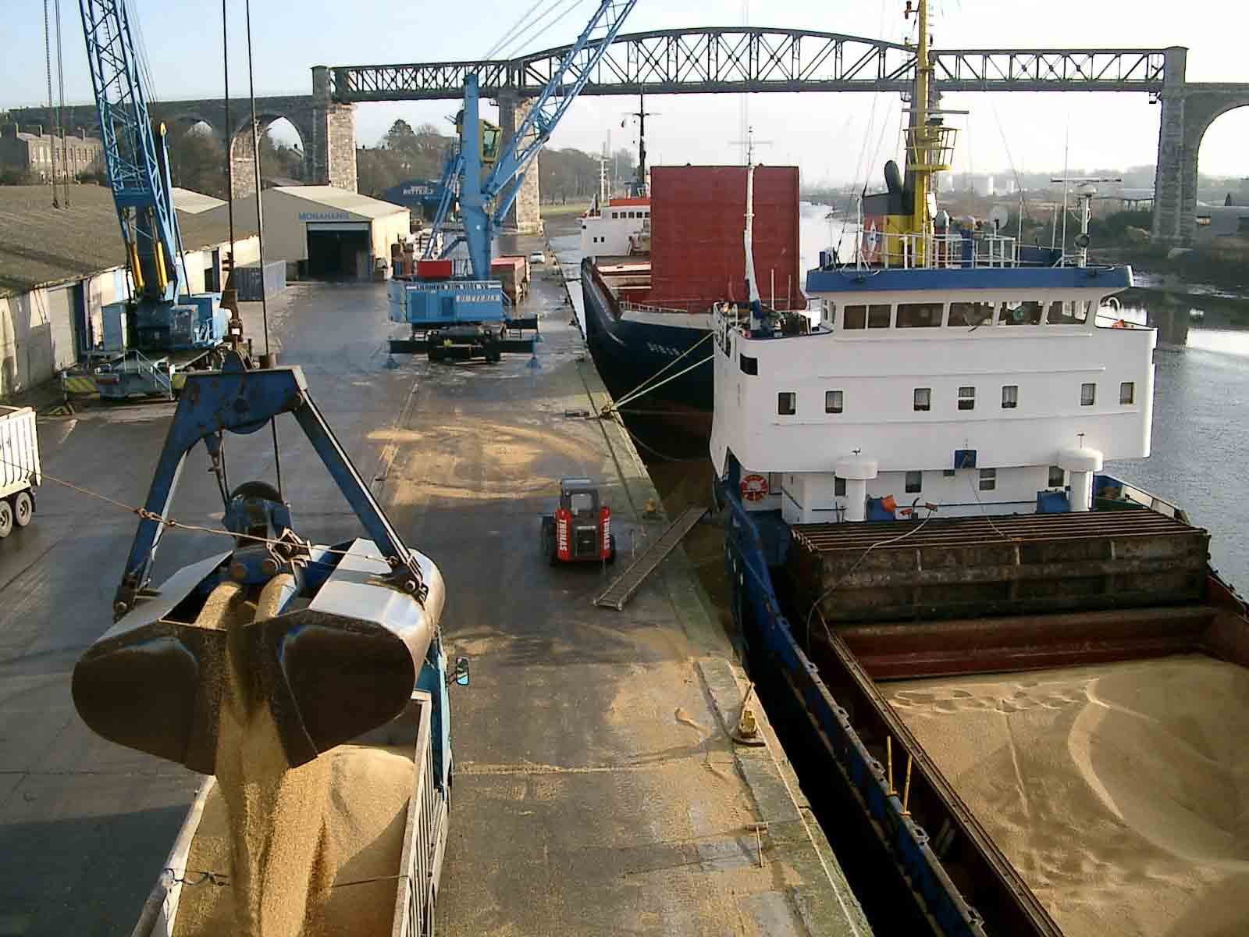

Slide 12
E.g. CARGO: **** MT 10% MOLOO
DECLARATION（宣载）
“About ”---if within the tolerance/margin, no misrepresentation or breach of contract on the part of shipowners; larger capacity ships a smaller margin, in percentage terms, is appropriate.
“without guarantee”/ WOG ---
to act in good faith/ honestly

Slide 13
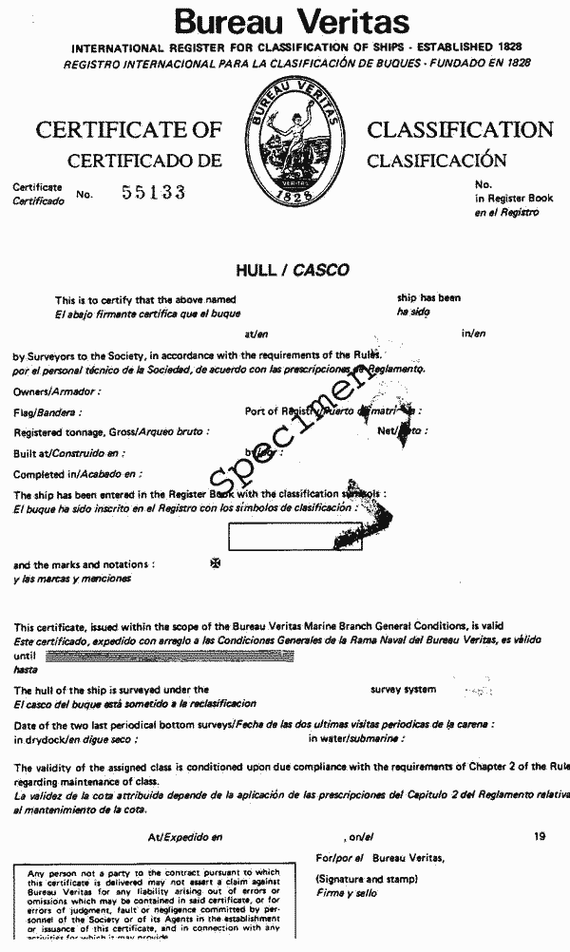
Vessel’s class
Classification society:
BV – DNV – LR – CCS - GL
Q: When the ship must comply?

Slide 14
Q: When the ship must comply?
Classification-relate solely to the date of the charterparty, no continuing warranty that the vessel will remain in class during the charter, unless otherwise agreed.
Speed & consumption – not only the date of contract establishment, but also on delivery.

Slide 15
“Asbatankvoy”
Express provisions requiring the owner to maintain the vessel’s class throughout the charter, or to exercise due diligence to maintain the class.

Slide 16
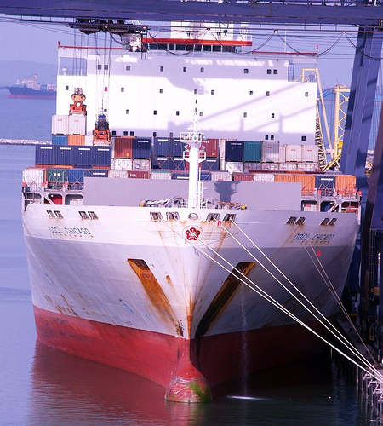
Vessel’s flag & nationality:
implied obligation not to change, during the currency of the charter.

Slide 17
Case:
A 12- month-charter contained no statement of vessel’s flag or nationality. After delivery her owners sold her, subject to charter, to Greek interests. The charterers, while continuing to perform the charter, claimed damages on the basis that they had suffered loss of sub-freights as a result of the ship’s change of flag.

Slide 18
Held:
“…I do not think it can be held that there is no difference under what flag a ship sails. The law of the flag is of importance, and the collateral effects of the law of the flag are also material. The morale of the crew and a hundred matters, it may be, are all matters capable of being of very great importance.”

Slide 19
Year of built
Condition of the vessel and her gear
“self-discharging”
---cranes in working order and crew available and prepared to operate the equipment. If applicable regulations prevent the crew from performing, extra discharging expenses for charterer’s account.

Slide 20
“Suitable for grab discharge”:
--- should be given a commercially sensible construction and does not mean that the owner has warranted that no hand shovelling will be necessary.

Slide 21
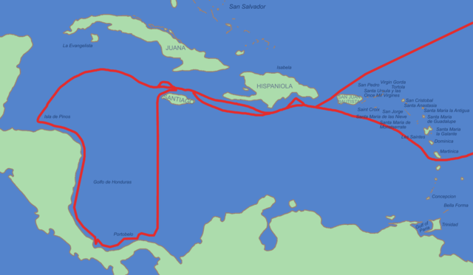
2. The agreed voyage
Present position
Expected ready to load
Ports of loading and discharging

Slide 22
Present position
“now in port of Amsterdam”
“now trading”
“now under repair”
importance
the extent of charterer’s reliance

Slide 23
Expected ready to load/ ETA
The "Baleares“, [1993] 1 Lloyd’s Rep. 215.
implied obligation to state in good faith and on reasonable grounds;
to proceed with all reasonable despatch where ETA is agreed;

Slide 24
damages
ETA
cancellation
Charterers to prove that the delay frustrated the contract
Charterers to prove the owners’ fault
cancellation
damages
LAYCAN
Absolute right of cancellation

Slide 25
CMC Art. 97
If the shipowner has failed to provide the ship within the laydays fixed in the charter, the charterer is entitled to cancel the charter party.
Where the charterer has suffered losses as a result of the delay in providing the ship due to the fault of the shipowner, the shipowner shall be liable for compensation.

Slide 26
（2018）最高法民再239号案
约定：“日期暂定于2012年11月21日至2012年12月31日装船共9船。”
承租人主张：出租人未在暂定期内完成第9船运输，应赔偿承租人损失。
一审：不予支持；
二审：支持；
再审（最高院）：不予支持；

Slide 27
（2018）最高法民再239号案
最高院：
时间暂定，数量确定，有关双方责任、运费等均适用运输协议。但是，双方并未约定暂定期内未完成装卸9船应如何处理。 租家没有举证证明因船东的原因造成暂定期内未完成装卸9船，故不能认定船东对此负有违约责任。

Slide 28
(2019)沪民终171号
约定“上一港滞港船期顺延"，出租人主张应理解为“上一航次的任一港口滞港则船期顺延”。
法院：上一港即为涉案合同装货港的上一港，该港未发生滞港，船方不应将其履行其他航次合同过程中的风险转由本案航次的承租人负担，无权主张受载期顺延。

Slide 29
Tender of NOR vs. LAYCAN
The “Alpha Harmony”, [2019] EWHC 2522 (Comm)
Facts:
The laytime clause and cancellation clause in both the Head Charter and the Sub-Charter;
Laytime clause requires NOR to be tendered within permitted hours (within office hours 0800-1700 hours Monday to Friday and 0800-1100 hours Saturday);
Cancellation clause requires NOR to be tendered within certain dates (before 12:00 / 23:59 on Sunday 10 May);

Slide 30
The vessel tendered NOR by email at 0704 on 10 May 2015 which was a Sunday.
The sub-charterer cancelled the Sub-Charter at 2047 on Sunday 10 May 2015 and the head charterer cancelled the Head Charter at 0555 on Monday 11 May 2015.
The question is whether the cancellations were lawful in circumstances where, although notice of readiness had been tendered before the relevant time on the cancelling date, it had not been tendered during the permitted hours.

Slide 31
The Court agreed with the Owners and the Tribunal that the combined effect of the amendments to the standard wording of clauses 4 (cancelling clause) and 17 (laytime clause) was that, for the purposes of the cancelling clauses, there was no requirement that the NOR be delivered within office hours.

Slide 32
Held:
Sub-charter: the Court found reversed the Tribunal’s decision and held that the sub-charterers had been entitled to cancel.
Head-charter: the Court upheld the Tribunal’s decision that the cancellation was invalid.

Slide 33
Shipping Corp. of India v. Naviera, Lloyd's Rep. 1976, 1, 132 C.C.
The vessel was re-routed while under way to laod port, and this caused her not to meet the cancelling date. The charterer cancelled. The shipowner claimed damages for wrongful cancellation, and succeeded. The court held that the charterer could not invoke a contractual right which was brought about by his own conduct - even though the conduct was in itself lawful.

Slide 34
Ports of loading and discharging
specified or to nominate ports
“Rotterdam”;
“Amsterdam/Rotterdam/Antwerp”
“Bordeaux/Hamburg range”
“One safe port East Coast of United States ”

Slide 35
The charterer’s obligation to nominate:
--- to exercise election within specified /reasonable time: Gencon “on signing of bills of lading”
under no obligation to consult the shipowner’s convenience

Slide 36
Safe ports/berths:
What is a safe port/berth?

Slide 37
The Eastern City
"A port will not be safe unless, in the relevant period of time, a particular ship can reach it, use it and return from it without, in the absence of some abnormal occurrence（异常事件）, being exposed to danger which cannot be avoided by good navigation and seamanship“.
--- [1958] 2 Lloyd's Rep.127

Slide 38
Safe
physical / political / legal aspects
the port will not be unsafe if the danger is temporary and avoidable. (frustration delay - a unsafe port)

Slide 39
“The relevant period of time”
Not the date of the charter or the date of nomination but the time when the vessel, proceeding normally, can be expected to arrive at and remain at the port in due course.

Slide 40
“The particular ship”
The question of safety is one of fact depending on the particular ship and the particular situation.
A port may be safe for one ship but unsafe for another since the particular characteristics of a particular ship will be very relevant.

Slide 41
“In the absence of abnormal occurrence”
The port is unsafe only if the danger is a normal or usual characteristic of the port.
If the danger is an abnormal occurrence at the port (i.e. one which a reasonable person would not expect at that port), the port is not dangerous in the legal sense.

Slide 42
Abnormal occurrence
The charterer will not be in breach of his obligations if the cause of danger is an “abnormal occurrence”.
The Ocean Victory, [2015] EWCA Civ 16;
[2017] UKSC 35

Slide 43
“Danger which cannot be avoided by good navigation and seamanship”
Whatever the nature of the risk, the port will not be dangerous if the danger can be avoided by the use of reasonable care and skill on the part of the master and crew.
If more than a reasonable degree of skill is required to avoid the danger, then the port may be unsafe.

Slide 44
Who shall bear the obligation of safe port?

Slide 45
1) named ports---
if contains no express warranty as to safety, owners are treated as having assumed responsibility for ascertaining whether the vessel can safely approach, use and leave the berth or port by expressly agreeing to proceed there.
Case

Slide 46
Express warranty:
“always accessible” or “always available” or “reachable on arrival”
exercise of due diligence to nominate a safe port or berth (Shellvoy 6. cl. 3)
“one safe port Dalian” (the word “safe” constitutes an express warranty by the charterers)

Slide 47
The Houston City:
“… the shipowner must take the responsibility of ascertaining whether he can safely berth his ship there or will take the risk of doing so. If he agrees upon the place, then, subject to excepted perils, his liability to have his ship there is definite.”

Slide 48
CITGO Asphalt Ref. Co. v. Frescati Shipping Co., 206 L. Ed. 2d 391
“The plain language of the parties’ safe-berth clause establishes a warranty of safety, not a mere duty of due diligence.”

Slide 49
Except for:
    Shelltime4, clause 4(c): “Charterers shall use due diligence to ensure that the vessel is only employed between and at safe places (which expression when used in this charter shall include ports, berths, wharves, docks, anchorages, submarine lines, alongside vessels or lighters and other locations including locations at sea”

Slide 50
    Shellvoy5 and 6, Part II, clause 4: “Charterers shall exercise due diligence to order the vessel only to ports and berths which are safe for the vessel…”

Slide 51
2) Choice from a range of named ports:
The position is the same.
If the owners does not stipulate for an express warranty he may reasonably be assumed to be content to bear the risk of unsafety himself.

Slide 52
3) Choice from a number of unnamed ports within a range:
---depend on the specific terms of the charter.
E.g. “Bordeaux/Hamburg range”

Slide 53
4）Choice of a berth within a port:
E.g.
named ports, berth to be nominated.

Slide 54
A safe berth:
If the vessel is to proceed expressly to “one safe berth” the charterer has warranted the safety of the berth.
If the charterer is to nominate a berth (without specifying whether the berth is to be “safe”) at “a safe port” (e.g. one/two berths at one safe port East Coast North America) , the charterer has warranted the safety of both the port and the berth.

Slide 55
“1/2 safe berths Dalian”
only include movement within the port to and from a nominated berth;
the safe berth warranty does not relate to those dangers which affect the entire port or every berth within the port;

Slide 56
The APJ Priti
The vessel was fixed to carry cargo to "one/two safe berths Bandar Abbas, one/two safe berths Bandar Bushire, one/two safe berths Bandar Khomeini in charterers’ option". While proceeding to Bandar Bushire, the vessel was damaged by an Iraqi missile. The owners argued that this amounted to a breach of the safe berth warranty.

Slide 57
“Where all the berths or the port as a whole are prospectively unsafe, the owners should not have agreed the discharge port in the first place or the master should have taken advantage of the clauses entitling him to discontinue the voyage.”
Bingham L.J. in “The A.P.J. Priti”

Slide 58
Case:
In case of unnamed ports and berths and safety of berth confirmed by owners, charterers were still held liable for unsafe berth.

Slide 59
At what time does the warranty as to safety operate?

Slide 60
If the charter provides for the ship to proceed to a named port which is warranted to be safe then the obligation arises when the charter is signed.
If the charter provides for the nomination of ports during the charter, the obligation arises when the port is nominated.
If the port is safe at the date of the charter or nomination, the port must stay safe at the time when the performance is due.

Slide 61
What if the nominated port ceases to be a safe one between nomination and vessel’s arrival?
Secondary obligation?
Frustration?
Other?

Slide 62
Rights of the shipowner
If it appears that the vessel is being ordered to proceed to an unsafe port contrary to the terms of the charter, the oweners are entitled to refuse the order.
If the port subsequently becomes unsafe the owners have the right to refuse to proceed further.

Slide 63
‘Or so near thereto as she may safely get’
conditions to invoke---subject to narrow construction
legal significance:
CMC article 91

Slide 64
Damages recoverable:
Physical damage
The cost of avoiding danger
Detention losses

Slide 65
Preliminary voyage: the voyage to the loading port
1) first stage of the performance of V/C
2) exception clause under V/C applicable: GENCON Clause 2(2)

Slide 66
3) to proceed to the loading port with reasonable despatch
“as soon as her prior commitments have been completed”

Slide 67
4) interpellation clause（质询条款）
GENCON clause 9 “cancelling clause” (b):

Slide 68
End of Section 1

Slide 69
CMC Article 91(1)
If, due to force majeure or any other causes not attributable to the fault of the carrier or the shipper, the ship could not discharge its goods at the designated port of destination, unless the contract provides otherwise, the Master shall be entitled to discharge the goods at a safe port or place near the port of destination and the contract of carriage shall be deemed to have been fulfilled.

Slide 70
CMC Article 97(1)
…However, if the shipowner had notified the charterer of the delay of the ship and the expected date of its arrival at the port of loading, the charterer shall notify the shipowner whether to cancel the charter within 48 hours of the receipt of the shipowner‘s notification.

